Slide 1


DESIGN 1
Lesson 4: Review & Practical Task: Lists in Context
Ms. Abboud • Grade 9 - Design 1 • Term 1, Week 4

Slide 2
Learning Objectives
WALT - We Are Learning To
WILF - What I'm Looking For
Demonstrate correct, independent use of ordered and unordered lists.
Organize information clearly for a real practical task.
I create lists correctly.
I select appropriate list types.
I present information clearly.

Slide 3
Frayer Model: List Item (Review)
DEFINITION
CHARACTERISTICS
The <li> tag - each individual entry inside an ordered or unordered list.
Always placed inside a <ul> or <ol>; must be properly opened and closed; can itself contain a nested list.
LIST ITEM
EXAMPLES
NON-EXAMPLES
<li>Coding</li>
A <p> placed directly inside a <ul>, with no <li> wrapper - invalid structure.

Slide 4
National Identity Integration
UAE Heritage and Culture: today's practical task organizes real UAE cultural content, just like real Emirati businesses and government sites present traditions and information clearly for every visitor.

Slide 5
STARTER
Tag Review Game
Quick-fire: flash <ul>, <ol>, <li> on the screen - students say what each one does.
Hook • Engage & Ask
5 - 10 minutes

Slide 6
LESSON CORE
I Do: Peer Review & Task Intro
Partners check each other's lists against the success criteria: correct type, correct syntax, clear content.
Explain today's practical task - and preview next week: today's lists are about to become a real navigation menu.
Gradual Release of Responsibility
30 - 40 minutes
1 / 2

Slide 7
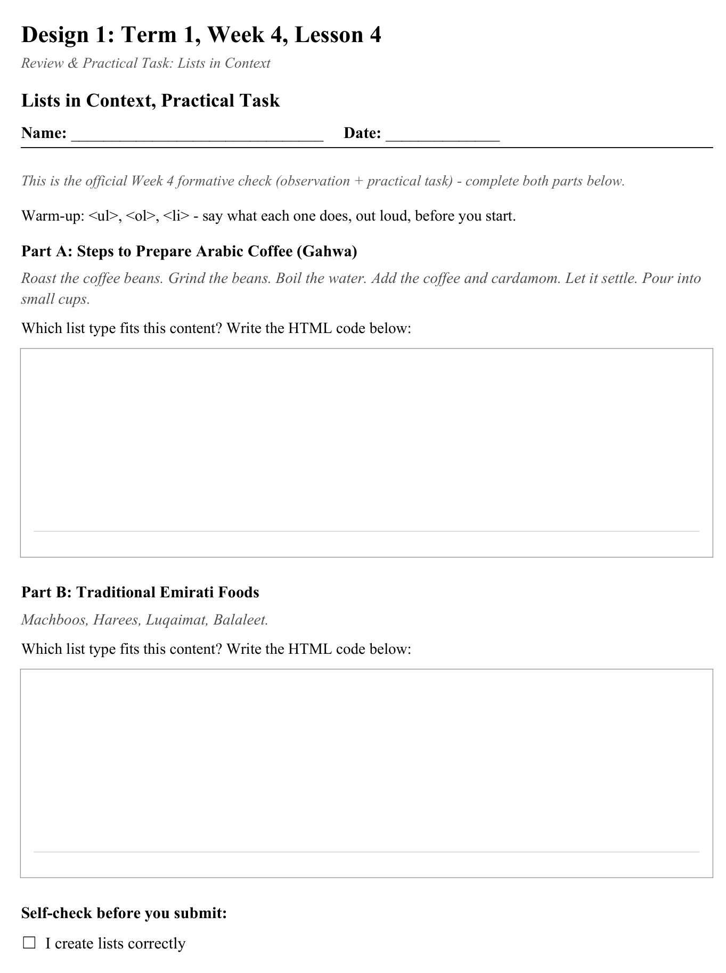
LESSON CORE
You Do: Lists in Context
Complete the practical list-organizing task and submit it for this week's formative check.
Activity: Lists in Context, Practical Task
Gradual Release of Responsibility
30 - 40 minutes
2 / 2

Slide 8
CLOSURE
Exit Ticket
One website (real or your own) that uses lists well, and why they work there.
Transition & Extend
5 - 10 minutes

